Slide 2
Executive Summary
A Data for Progress poll finds a very close House race, with Alyse Galvin slightly favored
  Republican Don Young is struggling on favorability, coming in at around 45% approval overall but just 10% among Democrats
  Galvin is picking up 51% of Independents, and making inroads with Republicans as well
  High percentages of respondents say they’re unsure who they will support, indicating a fluid race

Slide 3
Executive Summary
Methodology
Between May 21st and May 27th, 2020, Data for Progress conducted a survey of 589 likely voters matched to the voter file in Alaska using a text-to-web survey from respondents from a commercial voter file. The sample was weighted to be representative of likely voters by age, gender, education, race, and voting history. The survey was conducted in English. The margin of error is ± 4.0 percent.

Slide 4
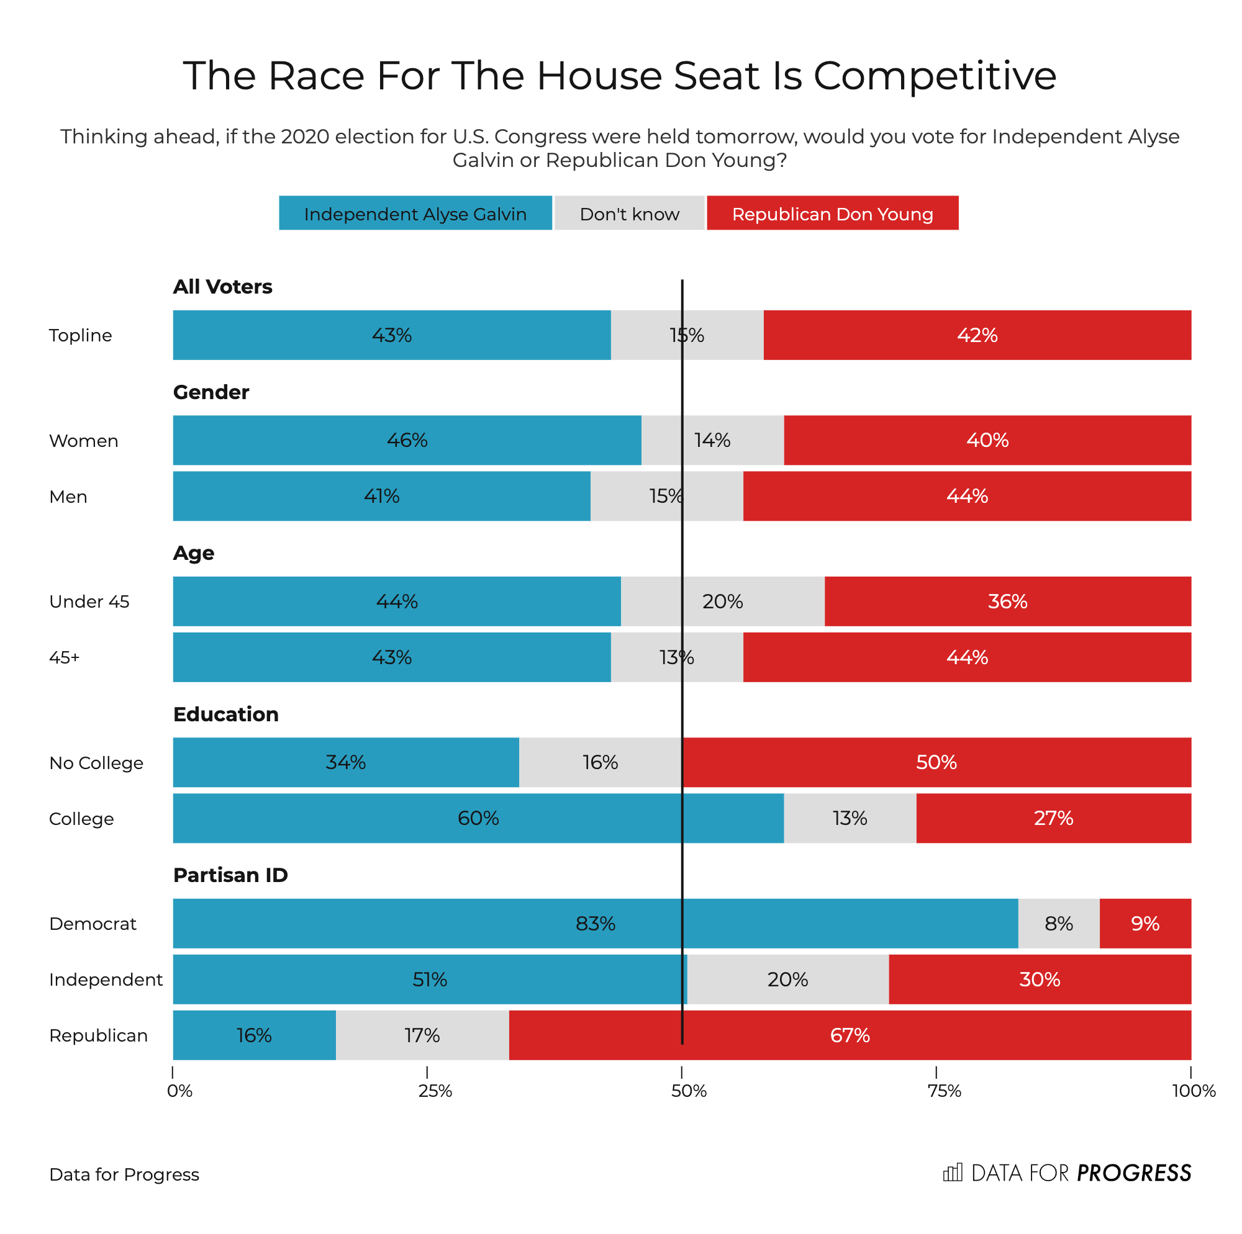

Slide 5
